Slide 1
ML-PDE lectures: Overview
Lecture 1 – Essentials of Neural Networks & Machine Learning.
Lecture 2 – Google Colab Usage, Convolutional Neural Networks Introduction, ML-PDE Project Overview.
Lecture 3 – TensorFlow in Colab: Implementing NNs & CNNs for MNIST.
Lecture 4 – Advanced Machine Learning & Deep Learning Topics; Project Discussion.

Slide 2
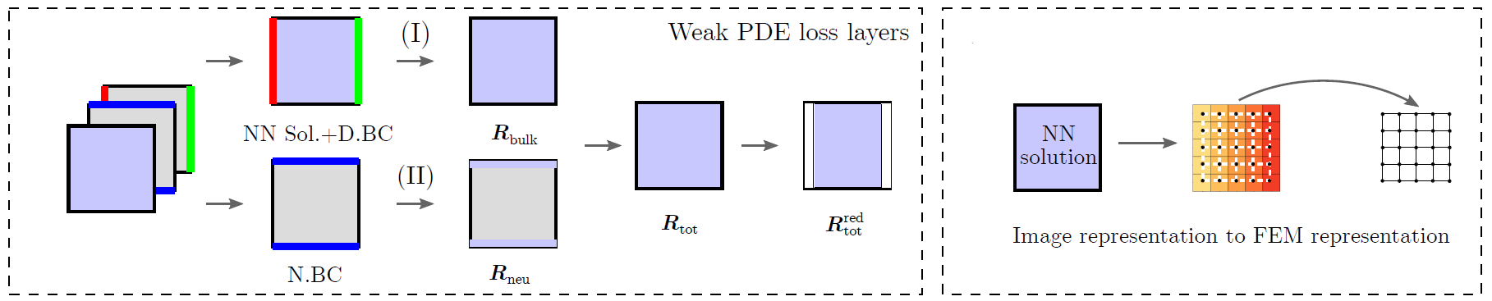
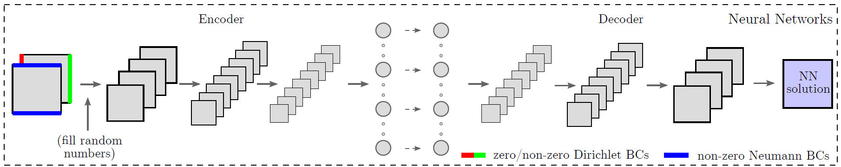
Final project overview
Part 1. Calculating the residual of a 2D linear Dirichlet boundary value problem (BVP) defined on a square image using quadrilateral finite elements
Part 2. Solving the problem by training a convolutional autoencoder neutral network with the FEM residual (part 1) as a custom loss function.
Tools: Python, NumPy, TensorFlow, Google Colab

Slide 3
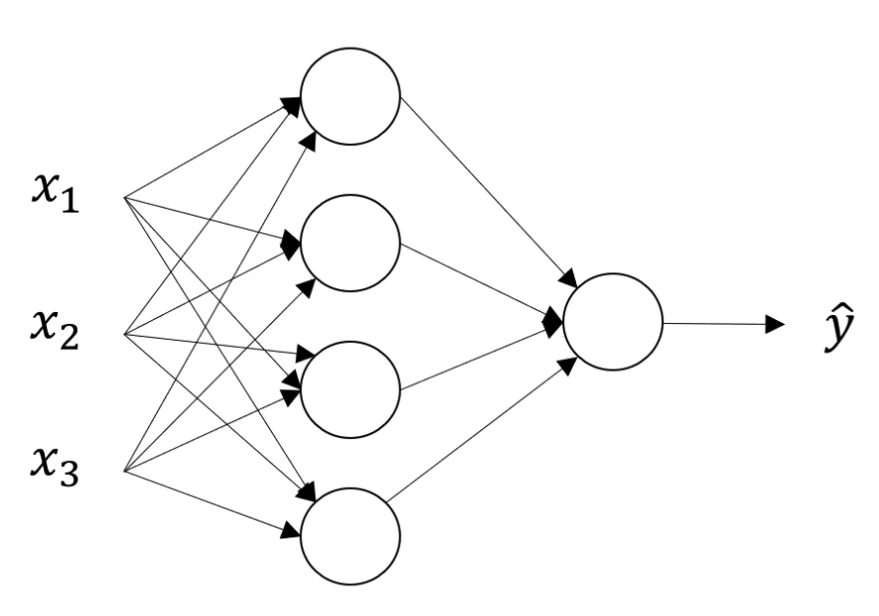
Neural Network Representation
2-Layer NN
Based on slides by DeepLearning.AI and Andrew Ng

Slide 4
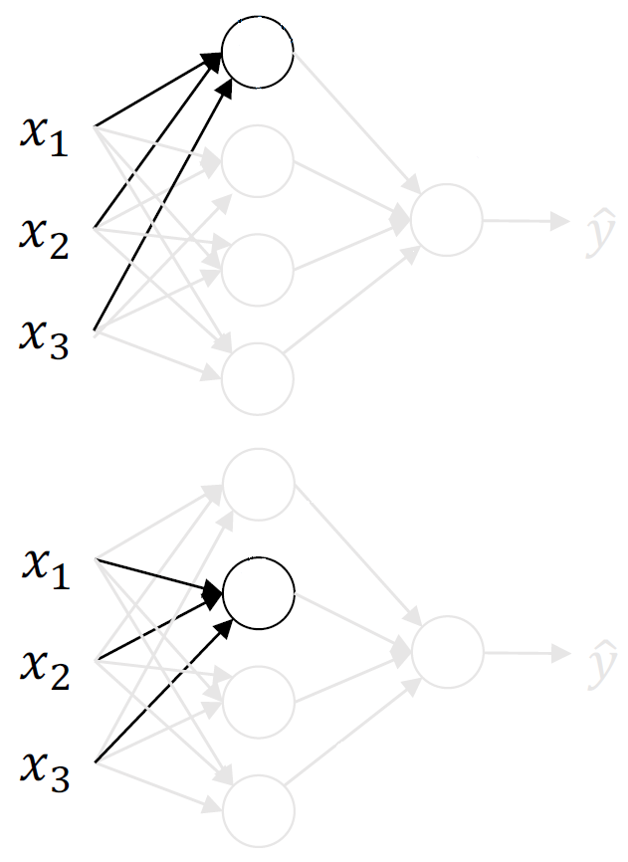
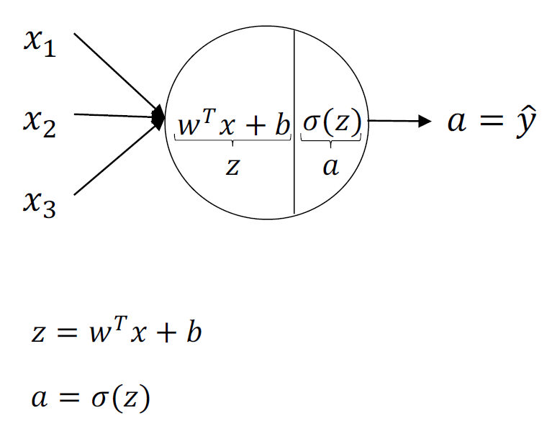
Neural Network Representation
Simplest case: 1-Layer NN
Based on slides by DeepLearning.AI and Andrew Ng

Slide 5
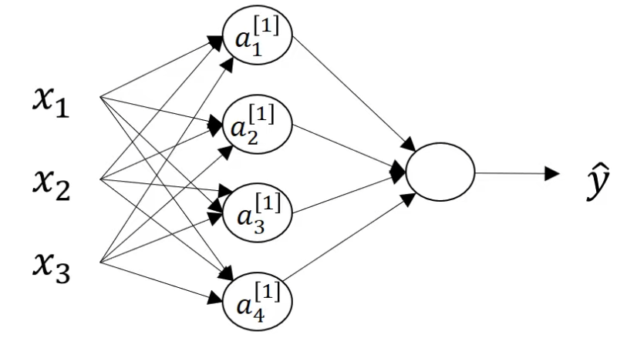
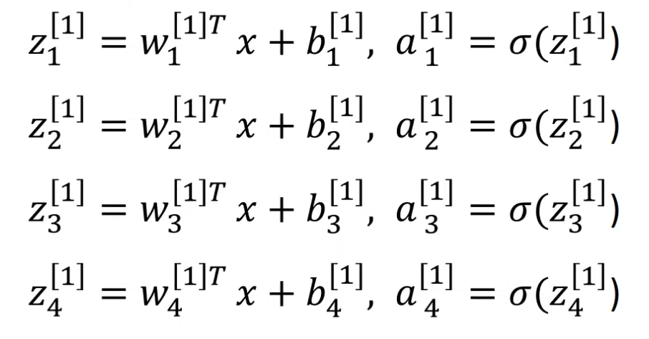
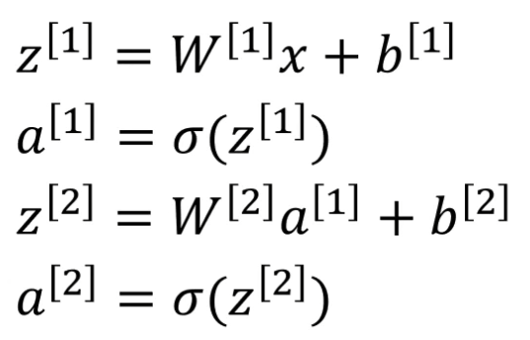
Neural Network Representation: Vectorizing across $W$and $b$
vectorizing
Based on slides by DeepLearning.AI and Andrew Ng

Slide 6
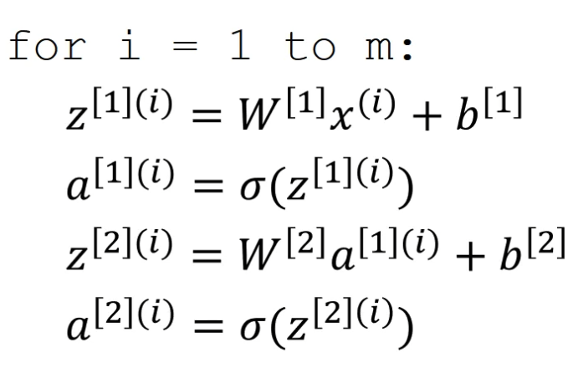
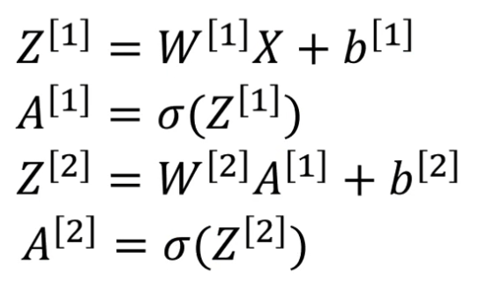
Neural Network Representation: Vectorizing across examples $x$
vectorizing
Based on slides by DeepLearning.AI and Andrew Ng

Slide 7
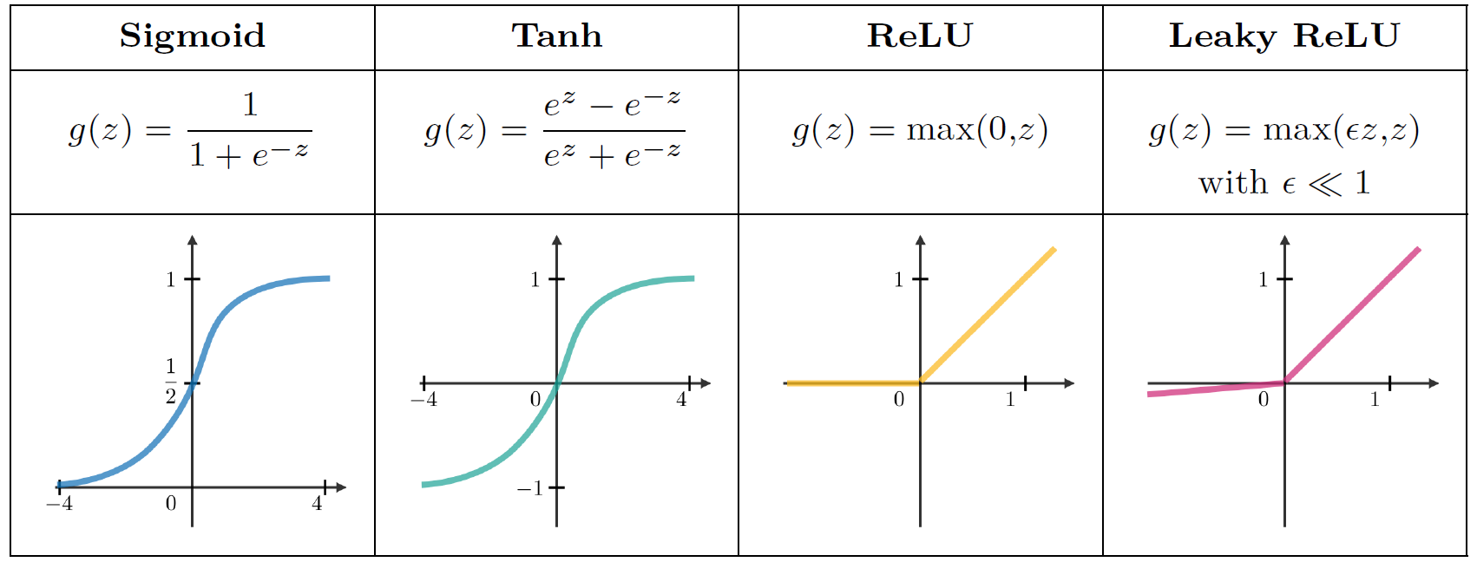
Activation functions
Activation functions introduce non-linear complexities to the model.
Activation functions can be different for each layer
From Super VIP Cheatsheet: Deep Learning, Afshine Amidi and Shervine Amidi, 2018

Slide 8
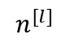
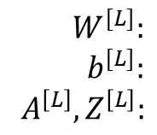
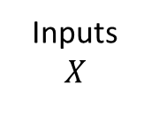
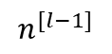
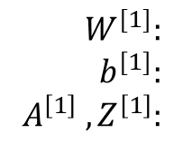
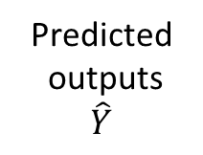
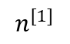
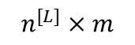
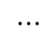
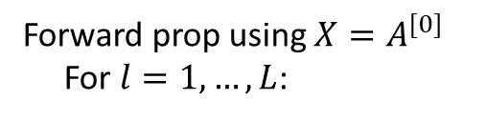
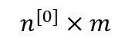
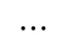
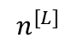
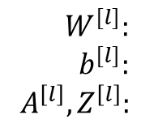
Forward propagation
Inputs
$$X$$
Predicted outputs
$$\hat{Y}$$
$$⋯$$
$$⋯$$
$$n^{[L]}$$
$$n^{[L]}×m$$
$$n^{[0]}×m$$
$$n^{[l−1]}$$
$$n^{[l]}$$
$$n^{[1]}$$
Forward prop using $X=A^{[0]}$
For $l=1,…,L$:
Sizes:
$$W^{[l]}:$$
$$b^{[l]}:$$
$$A^{\left[l\right]},Z^{\left[l\right]}:$$
$$W^{[1]}:$$
$$b^{[1]}:$$
$$A^{\left[1\right]} , Z^{\left[1\right]}:$$
$$W^{[L]}:$$
$$b^{[L]}:$$
$$A^{\left[L\right]},Z^{\left[L\right]}:$$

Slide 9
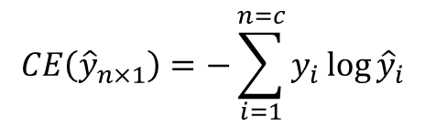
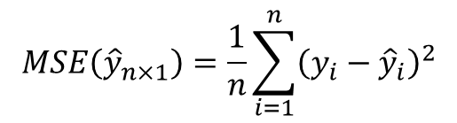
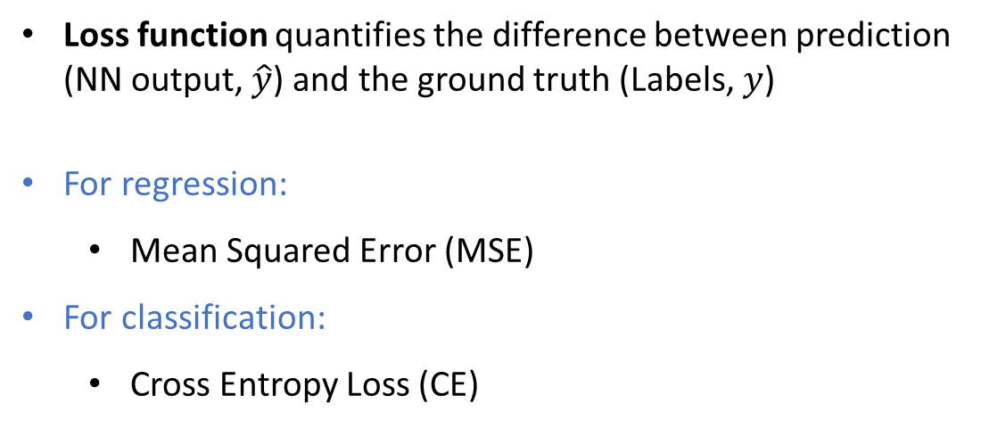
Loss functions
Loss function quantifies the difference between prediction (NN output, $\hat{y}$) and the ground truth (Labels, $y$)
For regression:
Mean Squared Error (MSE)
For classification:
Cross Entropy Loss (CE)
Mean Squared Error (MSE)
Cross Entropy Loss
classes
Prediction
Prediction
$$MSE\left({\hat{y}}_{n×1}\right)=\frac{1}{n}\sum_{i=1}^{n}{{\left(y_{i}−{\hat{y}}_{i}\right)}^{2}}$$
$$CE\left({\hat{y}}_{n×1}\right)=−\sum_{i=1}^{n=c}{y_{i}\log{{\hat{y}}_{i}}}$$
Ground truth
Ground truth {0,1}
Based on 2019 slides by Lex Fridman for MIT Deep Learning and Artificial Intelligence Lectures

Slide 10
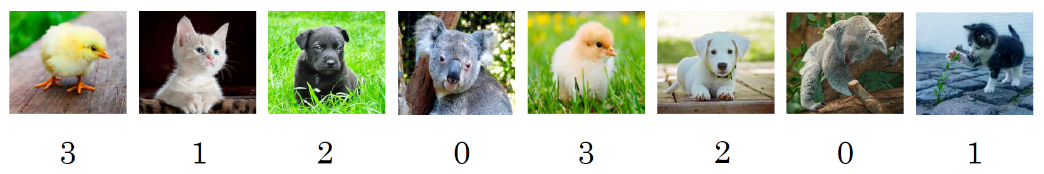
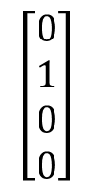
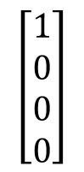
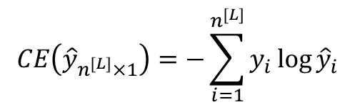
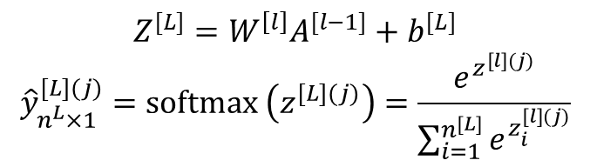

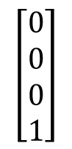

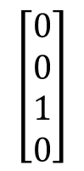
Classification using softmax activation
Ground truth $y$: one vs zero
Prediction $\hat{y}$: Softmax activation
Cross Entropy Loss
koalas
cats
dogs
chicks
$$Z^{[L]}=W^{\left[l\right]}A^{[l−1]}+b^{[L]}$$
$${\hat{y}}_{n^{L}×1}^{[L](j)}=softmax \left(z^{[L](j)}\right)=\frac{e^{z^{[l](j)}}}{\sum_{i=1}^{n^{[L]}}{e^{z_{i}^{[l](j)}}}}$$
classes
Prediction
$$\left[\begin{matrix}1 \\ 0 \\ 0 \\ 0\end{matrix}\right]$$
$$\left[\begin{matrix}0 \\ 1 \\ 0 \\ 0\end{matrix}\right]$$
$$\left[\begin{matrix}0 \\ 0 \\ 1 \\ 0\end{matrix}\right]$$
$$\left[\begin{matrix}0 \\ 0 \\ 0 \\ 1\end{matrix}\right]$$
$$CE\left({\hat{y}}_{n^{[L]}×1}\right)=−\sum_{i=1}^{n^{[L]}}{y_{i}\log{{\hat{y}}_{i}}}$$
Softmax converts a vector of numbers into a vector of probabilities.
Probability of a value is proportional to its relative scale in the vector.
Ground truth
Based on slides by DeepLearning.AI and Andrew Ng

Slide 11
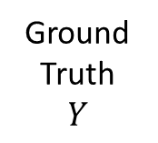
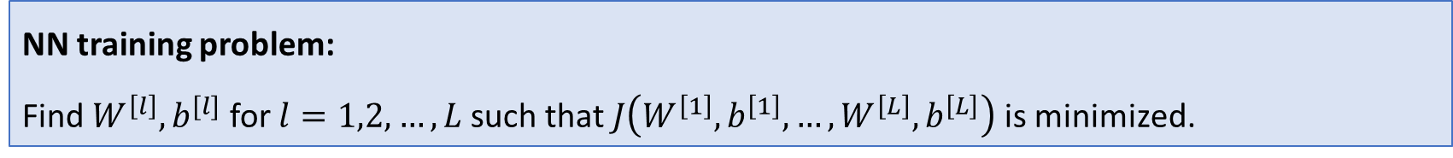
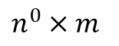
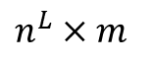
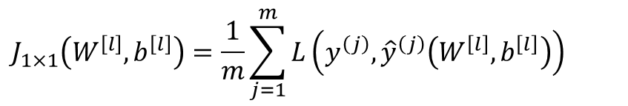
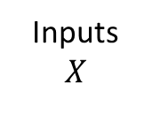
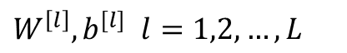
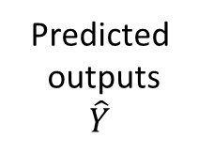
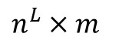
Cost function of NNs as a function of parameters $W$, $b$
$W^{\left[l\right]}, b^{[l]}$ $l=1,2,…, L$
Hidden
Layers
Predicted outputs
$$\hat{Y}$$
Inputs
$$X$$
MSE or CE
$n^{L}×m$
$$J_{1×1}\left(W^{\left[l\right]},b^{\left[l\right]}\right)=\frac{1}{m}\sum_{j=1}^{m}{L\left(y^{\left(j\right)},{\hat{y}}^{\left(j\right)}\left(W^{\left[l\right]},b^{\left[l\right]}\right)\right) }$$
$n^{0}×m$
Ground Truth
$$Y$$
Average over columns
$n^{L}×m$
NN training problem:
Find $W^{\left[l\right]}, b^{[l]}$ for $l=1,2,…, L$such that $J\left(W^{\left[1\right]},b^{\left[1\right]},…,W^{\left[L\right]},b^{\left[L\right]}\right)$ is minimized.

Slide 12
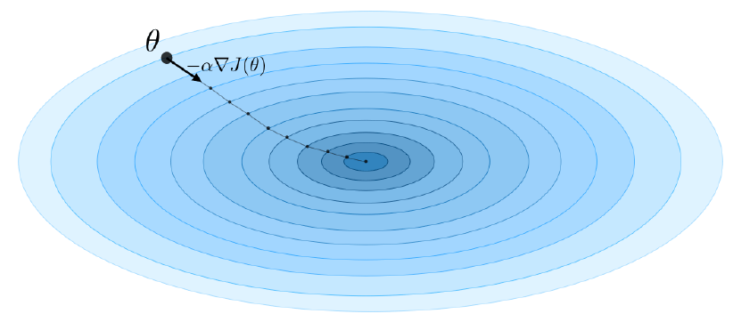
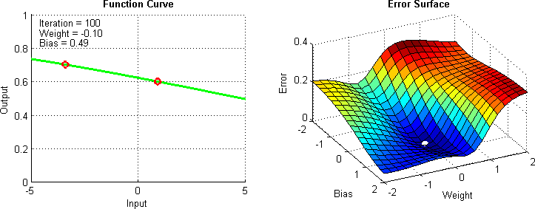
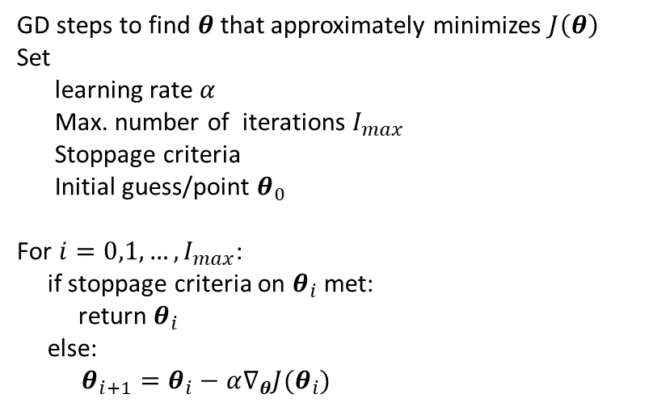
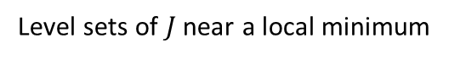
Gradient descent
Gradient descent (steepest descent) is an iterative optimization algorithm for finding a local minimum of a differentiable function
GD steps to find $θ$that approximately minimizes $J\left(θ\right)$
Set
learning rate $α$
Max. number of iterations $I_{max}$
Stoppage criteria
Initial guess/point $θ_{0}$
For $i=0,1, …,I_{max}$:
if stoppage criteria on $θ_{i}$met:
return $θ_{i}$
else:
$θ_{i+1}=θ_{i}−α∇_{θ}J(θ_{i})$
Level sets of $J$ near a local minimum
Image from From Super VIP Cheatsheet: Deep Learning, Afshine Amidi and Shervine Amidi, 2018
Gif from https://towardsdatascience.com/coding-deep-learning-for-beginners-linear-regression-gradient-descent-fcd5e0fc077d

Slide 13
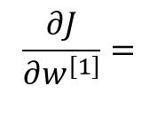
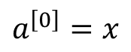






Backpropagation – finding $∇_{w}J,∇_{b}J$using chain-rule
1
2
$$a^{\left[0\right]}=x$$
$$\hat{y}=a^{[2]}$$
$$z^{[1]}=w^{[1]}a^{[0]}+b^{[1]}$$
$$a^{[1]}=g^{[1]}(z^{[1]})$$
$$z^{[2]}=w^{[2]}a^{[1]}+b^{[2]}$$
$$a^{[2]}=g^{[2]}(z^{[2]})$$
$$\frac{∂J}{∂w^{\left[2\right]}}=$$
$$\frac{∂J}{∂b^{\left[2\right]}}=$$
$$\frac{∂J}{∂w^{\left[1\right]}}=$$
$$\frac{∂J}{∂b^{\left[1\right]}}=$$

Slide 14











Backpropagation: Vectorized
Cost function: $J_{1×1}\left(W^{1},b^{1},…,W^{L},b^{L}\right)=\frac{1}{m}\sum_{j=1}^{m}{L^{(j)}}$
$$L_{1×1}^{(j)}=L\left({{\hat{y}}^{(j)}}_{n^{L}×1},y_{n^{L}×1}^{(j)}\right)$$
${\hat{Y}}_{ }=g^{L}\left(W_{ }^{L}A_{ }^{L−1}+b_{ }^{L}\right)$
$$X_{n^{0}×m}$$
$$⋯$$
$${\hat{Y}}_{n^{L}×m}$$
$$n^{1}$$
$$n^{2}$$
$$n^{L}$$
Forward propagation:
Backpropagation:
$$For l=1,2,…,L:$$
$$Z_{n^{l}×m}^{l}=W_{n^{l}×n^{l−1}}^{l}A_{n^{l−1}×m}^{l−1}+b_{n^{l}×1}^{L}{\left[1,⋯,1\right]}_{1×m}$$
$$A_{n^{l}×m}^{l}=g^{l}\left(Z_{n^{l}×m}^{l}\right)$$
$$For l=L,…,2,1:$$
$$Δ_{n^{l}×m}^{l}= \left\{\begin{aligned}∇_{a^{l}}J\left(A^{l}\right)∘{g′}^{l}\left(Z^{l}\right), l=L \\ \\ \left({W^{l+1}}^{T}Δ^{l+1}\right)∘{g^{′}}^{l}\left(Z^{l}\right), 1≤l<L\end{aligned}\right.$$
$$\frac{∂J}{∂W^{l}}=Δ^{l}{A^{l−1}}^{T}, \frac{∂J}{∂b^{l}}=Δ^{l}{\left[\begin{matrix}1 \\ ⋮ \\ 1\end{matrix}\right]}_{m×1}$$
More useful derivatives:
$$\frac{∂J}{∂X}={W^{1}}^{T}Δ^{1}$$
$$\frac{∂\hat{Y}}{∂X}=?$$

Slide 15












Mini-batch gradient descent
mini batch $1$
mini batch $t$
$$m^{t}=\frac{m}{n_{b}}$$
mini batch $n_{b}$
$$X_{n^{0}×m}$$
$$X_{n^{0}×m^{t}}^{\{t\}}$$
$$J$$
$$J^{\left\{t\right\}}$$
$$Y_{n^{L}×m}$$
$$Y_{n^{L}×m^{t}}^{\{t\}}$$
While SG stoppage criteria is not met and $i<I_{max}:$
epochs
# mini-batch iterations over all epochs
For $t=1,…,n_{b}:$
Forward prop using $X^{\{t\}}=A^{\left\{t\right\}\left[0\right]}$
For $l=1,…,L$:
$Z^{\{t\}\left[l\right]}=W^{\left[l\right]}A^{\{t\}\left[l−1\right]}+b^{\left[l\right]}$
$A^{\{t\}\left[l\right]}=g^{\left[l\right]}\left(Z^{\{t\}\left[l\right]}\right)$
Compute cost function $J^{\left\{t\right\}}={\frac{1}{m^{t}}\sum_{j=1}^{m^{t}}{L\left(y^{\{t\}\left(j\right)},{\hat{y}}^{\{t\}(j)}\right)}}_{ }$
Backprop to compute gradients $∇_{W^{\left[l\right]}}J^{\left\{t\right\}},∇_{b^{\left[l\right]}}J^{\left\{t\right\}}$
SG update:
$W^{\left[l\right]}=W^{\left[l\right]}−α∇_{W^{\left[l\right]}}J^{\left\{t\right\}}$
$b^{\left[l\right]}=b^{\left[l\right]}−α∇_{b^{\left[l\right]}}J^{\left\{t\right\}}$
1 epoch
1 pass through entire training set
Based on slides by DeepLearning.AI and Andrew Ng

Slide 16


What are hyperparameters?
Parameters: $W^{\left[l\right]}, b^{[l]} for l=1,2,…,L$
Hyperparameters:
Parameters that control the final values of parameters ($W, b$) obtained in backpropagation
Some examples:
Learning rate $α$
Minimization method (GD, mini-batch GD, Adam , etc.)
Max. number of minimization iterations
Number of hidden layers
Hidden unites $n^{[l]} for l=1,2,…$
Choice of activation functions (sigmoid, tanh, ReLU, etc.) $g^{\left[l\right]} for l=1,2,…,L$
Mini batch size
Regularization parameters
Momentum term
Any other parameters that we set before training for our model
Hyperparameter search/optimization/tuning: Finding the optimal set of hyperparameters for the learning process and model
Based on slides by DeepLearning.AI and Andrew Ng

Slide 17


TensorFlow
Based on 2019 slides by Lex Fridman for MIT Deep Learning and Artificial Intelligence Lectures

Slide 18




Convolutional Neural Networks (CNNs): Computer Vision Problems
Object detection: The goal of neural style transfer is to generate an image G based on a given content C and a given style S
Self-driving cars
Neural style transfer: The goal of neural style transfer is to generate an image G based on a given content C and a given style S
Face recognition: Is this one of the K persons in the database
Content from Super VIP Cheatsheet: Deep Learning, Afshine Amidi and Shervine Amidi, 2018
Based on slides by DeepLearning.AI and Andrew Ng
Notes:
https://www.semanticscholar.org/paper/A-Review-and-Comparative-Study-on-Probabilistic-in-Feng-Harakeh/5b0f30027f55d74006b0f56ab7d007cfd1564223

Slide 19









Image representation as matrices
Grayscale image
Color image
($n×m×1)$
Monitor/TV screen
($n×m×3)$
Images from https://ai.stanford.edu/~syyeung/cvweb/tutorial1.html
https://www.howtogeek.com/42393/rgb-cmyk-alpha-what-are-image-channels-and-what-do-they-mean/

Slide 20




What is convolution in deep learning?
Input array
Filter or Kernel
 | -2 | 2 | 3
0 | -2 | -4 | -7
-3 | -2 | -3 | -16
Based on slides by DeepLearning.AI and Andrew Ng
Content from Super VIP Cheatsheet: Deep Learning, Afshine Amidi and Shervine Amidi, 2018
Notes:
-5, -4, 0, 8, -10
Asterisk symbol shows convolution
Convolved feature, feature map, or activation map
https://stats.stackexchange.com/questions/291820/what-is-the-definition-of-a-feature-map-aka-activation-map-in-a-convolution

Slide 21






Convolution for edge detection
Vertical edge detection
Horizontal edge detection
Based on slides by DeepLearning.AI and Andrew Ng

Slide 22




Convolution for edge detection
1
0
-1
3
0
-3
Other edge detection filters:
2
0
-2
10
0
-10
1
0
-1
3
0
-3
Vertical Sobel filter
Vertical Scharr filter
Based on slides by DeepLearning.AI and Andrew Ng
Sobel operator Wikipedia

Slide 23





Developing convolution filters
Deep learning: consider a filter as some parameters and let backpropagation learn the best possible filter based on data and the loss function
Gaussian blur
*
filter 9 parameters
Edge detection using deep CNNS https://doi.org/10.1109/WACV45572.2020.9093290
Based on slides by DeepLearning.AI and Andrew Ng
Wikipedia Gaussian blur

Slide 24
Padding in convolution
0 | 0 | 0 | 0 | 0 | 0 | 0 | 0 | 0 | 0
0 | 0 |  |  |  |  |  |  |  | 0
0 | 0 |  |  |  |  |  |  |  | 0
0 | 0 |  |  |  |  |  |  |  | 0
0 | 0 |  |  |  |  |  |  |  | 0
0 | 0 |  |  |  |  |  |  |  | 0
0 | 0 |  |  |  |  |  |  |  | 0
0 | 0 |  |  |  |  |  |  |  | 0
0 | 0 |  |  |  |  |  |  |  | 0
0 | 0 | 0 | 0 | 0 | 0 | 0 | 0 | 0 | 0
Output
0 | 0 | 0 | 0 | 0 | 0 | 0 | 0
0 |  |  |  |  |  |  | 0
0 |  |  |  |  |  |  | 0
0 |  |  |  |  |  |  | 0
0 |  |  |  |  |  |  | 0
0 |  |  |  |  |  |  | 0
0 |  |  |  |  |  |  | 0
0 | 0 | 0 | 0 | 0 | 0 | 0 | 0
filter
*
=
Output size given input size of $n×n$ and filter size $f$:
Without padding
Output size shrinks
loosing information at the edges – pixels at the edges used less
Output size given input size of $n×n$, filter size $f$, and padding $p$:
Based on slides by DeepLearning.AI and Andrew Ng

Slide 25






Padding in convolution
Two common approaches:
“Valid” convolution – no padding $p=0$
Input size $=m×n$
Output size $=\left(m−f+1\right)×(n−f+1)$
“Same” convolution – pad such that the output size is the same as the input size ($f$ is usually odd)
Input size $=$ Output size $=$ $n×n$
Based on slides by DeepLearning.AI and Andrew Ng

Slide 26

Strided convolution
3 | 4 | 5
1 | 0 | 2
-1 | 0 | 3
91 | 100 | 83
69 | 91 | 127
44 | 72 | 74
*
=
Output size given, input $n×n$, filter size $f$, padding $p$, stride $s$:
Based on slides by DeepLearning.AI and Andrew Ng

Slide 27


2D Convolution over volume
Color image (RGB) channels
Arbitrary number of input channels
Input and filter have the same number of channels:
Based on slides by DeepLearning.AI and Andrew Ng
Images from https://blog.csdn.net/shiner_chen/article/details/124319246

Slide 28


2D Convolution over volume – multiple filters
4 $×$ 4 $×$ 2
Output size given input size $n×n×n_{c}$ and filter size $f×f×n_{c}$:
Based on slides by DeepLearning.AI and Andrew Ng

Slide 29














One layer of a convolutional network
$$a^{[0]}$$
$$W^{\left[1\right]}$$
$$W^{[1]}∗a^{[0]}$$
$$W^{[1]}∗a^{[0]}$$
$$b^{[0]}$$
$$ReLU$$
+
1 $×$ 1 $×$ 2
4 $×$ 4 $×$ 2
$$Z^{\left[1\right]}=W^{[1]}∗a^{[0]}+b^{[1]}$$
$$a^{\left[1\right]}=ReLU\left(Z^{\left[1\right]}\right)$$
$$a^{\left[0\right]}$$
$$f=3$$
$$a^{\left[1\right]}$$
$$4×4×2$$
$$6×6×3$$
Based on slides by DeepLearning.AI and Andrew Ng

Slide 30







Size relations in convolutional networks
If layer $l$ is a 2D convolution layer:
Input
Output
$f^{\left[l\right]}=$ filter size
$p^{[l]}=$ padding size
$s^{\left[l\right]}=$stride
$$f^{\left[l\right]},p^{\left[l\right]},s^{[l]}$$
$$a^{\left[l−1\right]}$$
$$a^{\left[l\right]}$$
$$n_{w}^{[l−1]}×n_{h}^{[l−1]}×n_{c}^{[l−1]}$$
$$n_{w}^{[l]}×n_{h}^{[l]}×n_{c}^{[l]}$$
Find the following:
Number of filters:
Weight size:
Filter size:
Bias size:
Output size:
Activation size:
Based on slides by DeepLearning.AI and Andrew Ng

Slide 31








Pooling layers
Max pooling
$$f=2,S=2$$
Average pooling
$$f=2,S=2$$
Input
Output
pooling
$$a^{\left[l−1\right]}$$
$$f^{\left[l\right]},p^{\left[l\right]},s^{[l]}$$
$$a^{\left[l\right]}$$
Output size:
$$n_{w}^{[l−1]}×n_{h}^{[l−1]}×n_{c}^{[l−1]}$$
Based on slides by DeepLearning.AI and Andrew Ng

Slide 32






UpSampling
1
1
2
2
UpSampling2D
nearest neighbor
1
2
1
1
2
2
4
3
$$f=2$$
4
4
3
3
4
4
3
3
Output
Input
UpSampling2D
$$a^{\left[l−1\right]}$$
$$f^{\left[l\right]}$$
$$a^{\left[l\right]}$$
$$n_{w}^{[l]}×n_{h}^{[l]}×n_{c}^{[l]}$$
Output size:

Slide 33


Convolutional network example: LeNet - 5
Softmax
10
Why convolution layers?
Parameter sharing: A feature detector (such as a vertical edge detector) that’s useful in one part of the image is probably useful in another part of the image.
Sparsity of connections: In each layer, each output value depends only on a small number of inputs- much fewer weights to train
Based on slides by DeepLearning.AI and Andrew Ng
[LeCun et al., 1998. Gradient-based learning applied to document recognition]

Slide 34


ML-PDE: NN architecture
Standard Autoencoder
Convolutional Autoencoder
Image from https://www.assemblyai.com/blog/introduction-to-variational-autoencoders-using-keras/

Slide 35







ML-PDE: NN architecture
$$32×32×1$$
$$32×32×1$$
$$2$$

Slide 36







ML-PDE: NN Input
General Input
Simplified input (No non-zero Neumann BCs)
$$(=0)$$
($=−2)$
$$(>0)$$
$=−1$ : margin between problem domain and background grid
$>0$ : boundary locations with boundary values
$=−2$ : domain interior filled with random numbers during training
$=0$ : zero Dirichlet boundary locations
$>0$ : non-zero Dirichlet boundary locations with boundary values
$=−2$ : domain interior filled with random numbers during training

Slide 37




ML-PDE: NN output and loss function
$$32×32×1$$
$$32×32×1$$
NN output is the solution of a PDE discretized by FEM
Label-free Loss function is based on residual of a PDE discretized by FEM
Canters of pixels are a nodes in the FEM mesh

Slide 38



ML-PDE: Simplified loss function using FEM (project part 1)
NN Input image
FEM residual
($=−2)$
$$(=0)$$
$$(>0)$$
NN output (PDE solution)
Element image from https://www.researchgate.net/publication/322932020_Numerical_results_quality_in_dependence_on_abaqus_plane_stress_elements_type_in_big_displacements_compression_test

Slide 39




Sample results

Slide 40


Supervised vs unsupervised learning
Clustering
Classification
Images from
https://doi.org/10.1186/s12052-021-00147-x Classificationhttps://www.altexsoft.com/blog/unsupervised-machine-learning/

Slide 41






Classification metrics
Confusion matrix
Content from Super VIP Cheatsheet: Deep Learning, Afshine Amidi and Shervine Amidi, 2018
Images form https://levity.ai/blog/precision-vs-recall

Slide 42



Model diagnostics
Validation set is assumed to be a representative of the testing set.
Final model is tested on the unseen test set.
Development set
Unseen set
Model diagnostics terminologies
“From a training standpoint”
Underfitting
Overfitting
“From a validation/testing standpoint”
High Bias: large change in inputs results in a small change in model outputs
High Variance: small change in inputs results in a large change in model outputs
Bias/variance tradeoff – The simpler the model, the higher the bias, and the more complex the model, the higher the variance (not necessary a tradeoff for DNNs)
Content from Super VIP Cheatsheet: Deep Learning, Afshine Amidi and Shervine Amidi, 2018 and 2019 slides by Lex Fridman for MIT Deep Learning and Artificial Intelligence Lectures

Slide 43



Regularization
Techniques for avoiding the model to overfit data and thus dealing with high variance issues.
Examples:
Early stoppage in model training
Dropout in NNs
Parameter/weight regularization
Data augmentation
Main weight regularization techniques
Dropout: dropping out neurons with probability $p>0$
Early stopping – Stop the training process as soon as the validation loss reaches a plateau or starts to increase.
Content from Super VIP Cheatsheet: Deep Learning, Afshine Amidi and Shervine Amidi, 2018

Slide 44


Data augmentation
Deep learning models need a lot of data to be trained.
Get more data from the existing ones using data augmentation techniques.
Content from Super VIP Cheatsheet: Deep Learning, Afshine Amidi and Shervine Amidi, 2018

